Slide 1


A new class of polarization-agile antennas for radar sensors and wireless applications
G. Biffi Gentili⁽¹⁾, A Vallecchi⁽¹⁾, G. Mauriello⁽²⁾, G. Guarnieri⁽²⁾
⁽¹⁾ University of Florence
Department of Electronics and Telecommunications
Microwave and Antenna Lab
⁽²⁾ Selex Galileo
Radar and Advanced Targeting Lab
Roma 15 Dicembre 2008

Slide 2
Summary
Definition and applications of polarization-agile antennas
Introducing a new planar antenna technology for the next generation polarization-agile radar sensors and wireless communications
X band ASR radar antenna prototype
Future developments

Slide 3
Polarization-agile antenna
An Antenna the polarization state of which can be dynamically changed
to enable different polarization states at different times
Mobile communications
MIMO Systems
Frequency reuse radio transceivers
to mitigate the fading caused by multipath propagation phenomena
Dual-polarization antenna
An Antenna capable of operating at two different (orthogonal)
polarization states at the same time
SAR Systems
Advanced ASR Radars
Imaging radar sensors
to provide two co-polar and two cross-polar sets of target scattering data

Slide 4
Research objective
To develop a new planar antenna (microstrip) technology to be employed in
building polarization-agile antennas for the next-generation Radar Sensors and
Wireless Transceivers
Requirements
High modularity
Conformability
Low weight, minimum thickness
High mechanical robustness
Low production cost
Scalability (from 2 GHz to 30 GHz)
Useful for a large class of wireless and radar antennas
Roles
UNIFI – concept, theory and design (under SG contract)
SG – engineering, assembly and measurements

Slide 5
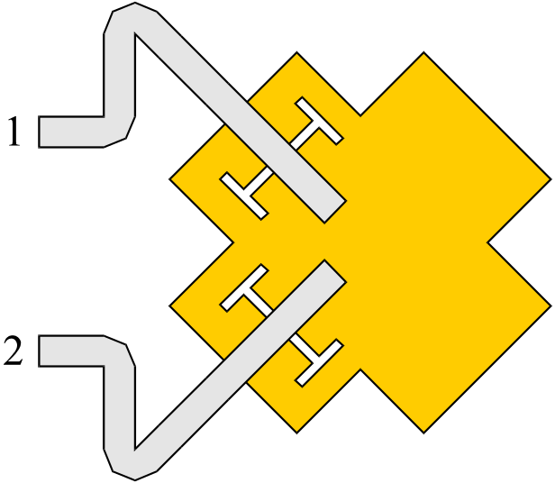
Microstrip Radiating Element
two orthogonal TM₀₁ resonant modes generate two orthogonal linear polarizations
By properly choosing driving amplitudes and phases, the antenna elements can operate either in linear or circular polarization
Input Port Excitation | Polarization
[1, 1] | Horizontal
[1,-1] | Vertical
[0, 1] | Slanted 45°
[1, 0] | Slanted 135°
[1, exp(jπ/2)] | Circular CW
[1, -exp(jπ/2)] | Circular CCW
Feeding Microstrip
Radiating Patch
Coupling Slot

Slide 6
Dual Polarization Serial Feed Linear Microstrip Subarray
Composed of many serially connected Four Port Radiating Elements (FPRE)
Terminated on a 2-port element acting as a Radiating Matched Load (RML)
Traveling-waves propagate from the input ports to the RML (no reflection)
RML
Port 1
Port 2
FPRE
Advantages:
Very reduced feedlines runs and no ending resistive (dissipative) matched load High radiation efficiency
Non resonant regime in the feeding microstrips and minimized discontinuities Wider bandwidth and low radiation losses
Symmetry of the subarray Low cross-polarization level
Input power subdivided between two feeding lines Maximum power doubled
A. Vallecchi and G. Biffi Gentili,” IEEE Transactions on Antennas and Propagation, vol. 53, no. 5, pp. 1791-
1798, May 2005

Slide 7
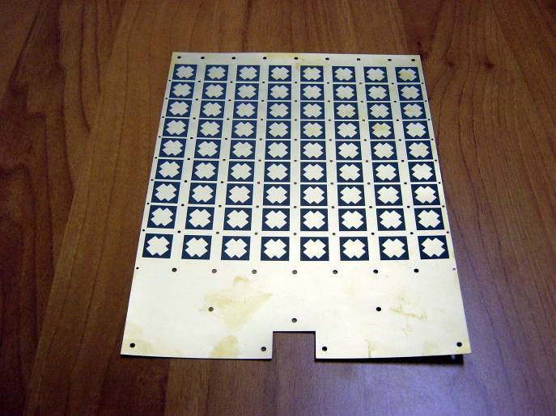
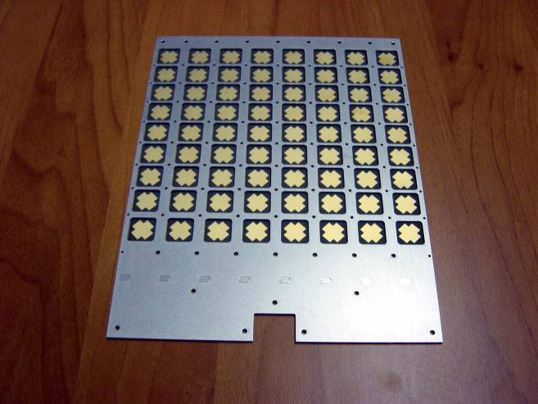
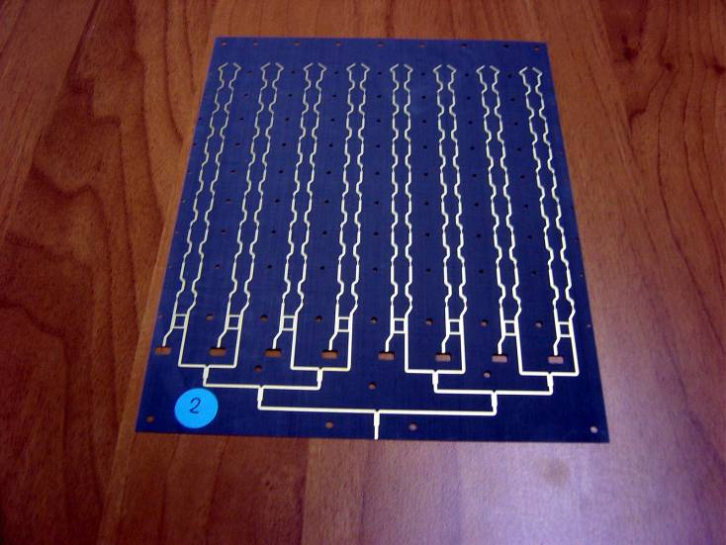
Multilayer Suspended Substrate Planar Technology
Tile with 9x8 radiating elements
First layer: Duroid 5880
( thickness 0.318 mm)
Radiating patches
Second layer: Aluminum grid (thickness 1.5 mm)
Cavities
Third layer: Duroid 5880 (thickness 0.318 mm)
Feeding lines and
coupling slots

Slide 8
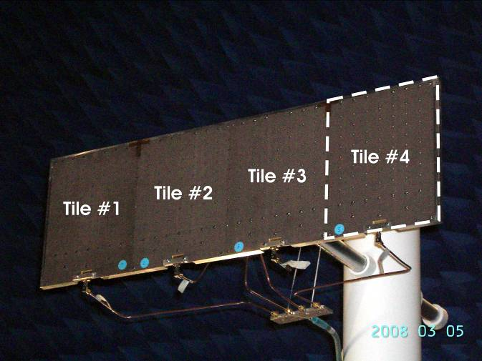
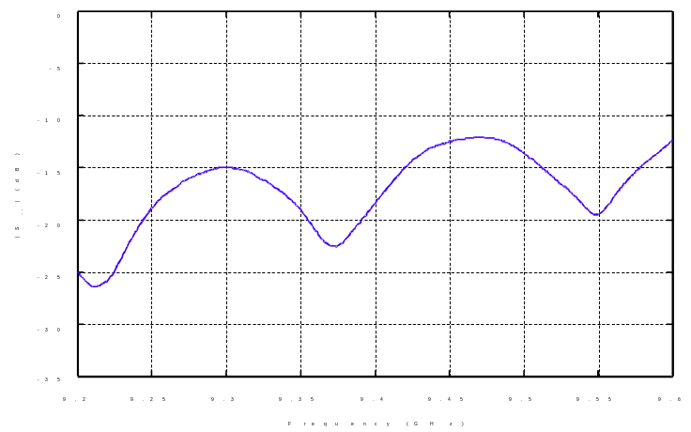
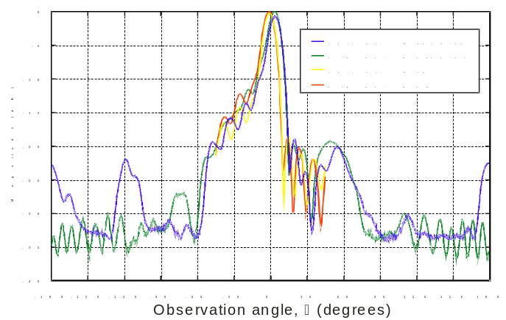
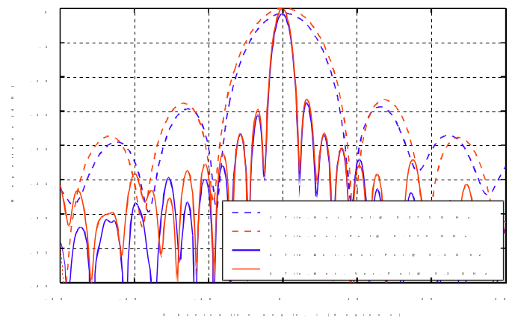
X Band CP Radar Antenna Demonstrator

Slide 9
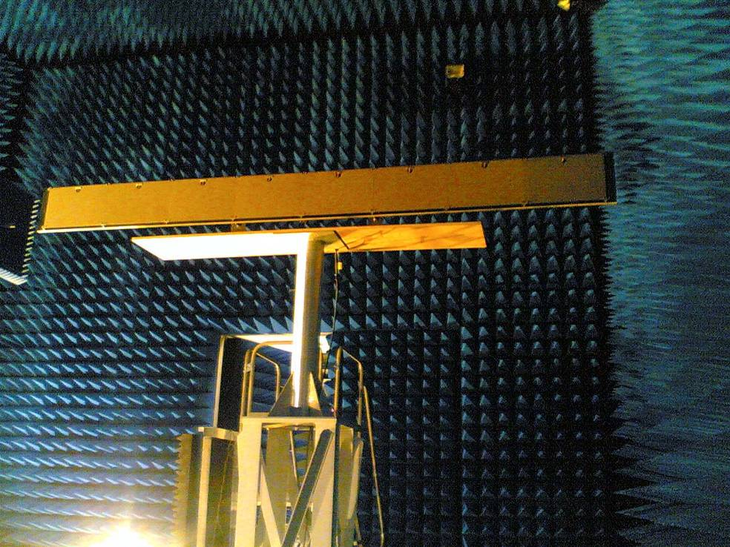
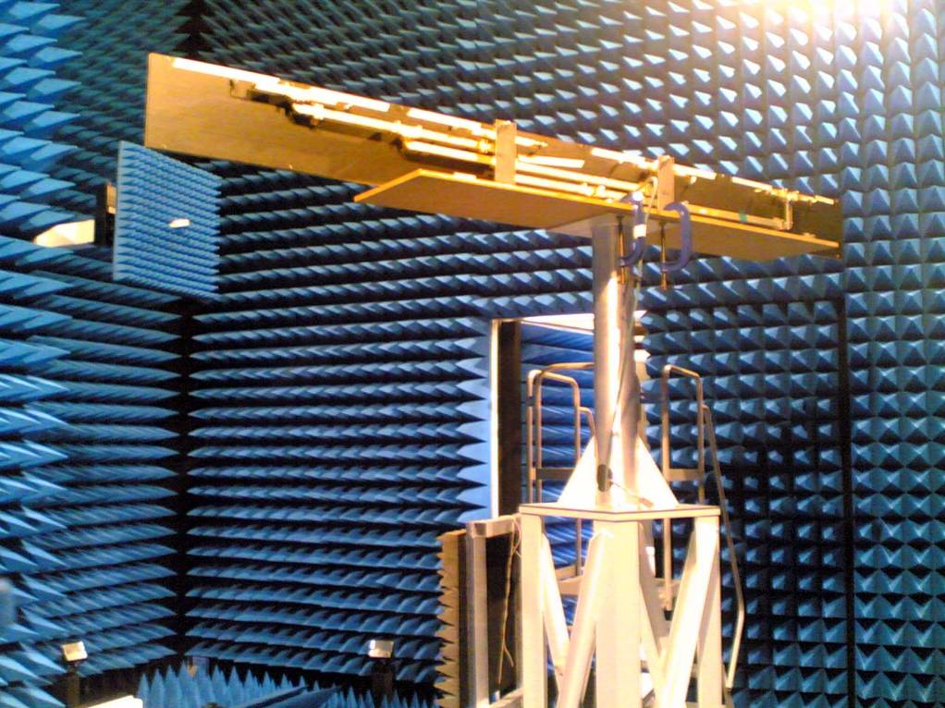
X Band CP 3.2m aperture ASR Hybrid Antenna prototype
Hybrid Corporate Feed Network
8 Tiles (1152 Radiating Elements)
Aperture length can be doubled using 16 Tiles (2304 Radiating Elements)

Slide 10
Dual-polarization Polarimetric Hybrid Array Architecture
Along horizontal direction the power distribution is realized by a couple of waveguide carrying a TE₁₀ mode
Along vertical direction the power distribution is realized by microstrip lines carrying a TEM mode
Microstrip feeding lines are coupled to the waveguides through probes
Hybrid feeding-network losses are minimized
λs/2
Port 1
λg/2
Port 2
A. Vallecchi and G. Biffi Gentili, “A low-cost shaped-beam hybrid-feed microstrip planar array antenna for X-band
polarimetric radar systems,“ 2006 European Radar Conference, Manchester, UK, September 2006.

Slide 11
FUTURE DEVELOPMENTS

Slide 12
A new electronic beam scanning technology
Electronic beam scanning can be obtained by periodically loading the microstrip feeding lines of the linear serial feed sub-array with MEMS switched capacitors
A MMIC integrating MEMS switches and loading capacitors will be designed and prototyped
Port 1
Port 2
Beam scanning plane
C1
C2
C3
MEMS Switched capacitor MMIC
C1
C2
C3

Slide 13

Adaptive/Smart Arrays
Hexagonal Switched-Beam Polarization-Agile Antenna
Wireless Applications
Conformal Polarization-Agile Phased-Array Antenna
Radar Applications

Slide 14
Conclusions
A new planar technology for polarization-agile antennas has been conceived and experimentally demonstrated
The new technology offers great flexibility and modularity for building many different antenna types from the simplest fixed-beam flat-panel to the more complex conformal phased arrays
The antenna’s polarization can be specifically tailored to the application at hand greatly increasing antenna efficiency and signal processing speed, while maintaining a small antenna size and high degree of flexibility
The modular concept and simplicity of construction possibly lends this new technology to a low-cost mass production

